Slide 1


Data Analysis
Notes:
Greetings, esteemed attendees. I am Shaghayegh, and it is my privilege to elucidate the findings of the Data Analytics task before you today.

Slide 2

c
Today's agenda
Project recap
Problem
The Analytics team
Process
Insights
Summary
Notes:
The schedule for today's proceedings is outlined as follows:
We will provide a comprehensive project overview to impart a high-level understanding of the business challenge at hand, along with its specific requirements.
We will delve into the specific challenge that our Data Analytics team has been diligently addressing, offering contextual background to underscore its significance.
Following the problem introduction, I will elaborate on the dedicated team from our side entrusted with the responsibility of addressing this task.
Subsequently, I will elucidate the overarching process we employed to accomplish this task, providing a comprehensive understanding of our approach in handling similar tasks.
Lastly, I will expound upon the pivotal outcomes, presenting them as a sequence of insights and visual representations derived from our thorough analysis.
In conclusion, I will provide a concise summary and welcome any inquiries or discussions.

Slide 3

Social Buzz is a rapidly expanding technology unicorn necessitating swift adaptation to its global scale. Accenture has embarked on a three-month Proof of Concept (POC) centered on the following objectives:
A comprehensive evaluation of Social Buzz's big data methodology.
Guidelines for an Effective Initial Public Offering (IPO).
A study aimed at identifying the five most prominent content categories within Social Buzz.
Project Recap
Notes:
To commence, allow me to provide a brief overview of this engagement.
Accenture has initiated a three-month pilot program with Social Buzz, dedicated to addressing three primary tasks that align with some of the most significant challenges currently encountered by your organization.
In recent years, Social Buzz has achieved substantial growth, earning recognition as a global unicorn company. Our purpose is to assist you in effectively managing this scale and providing strategic guidance for your continued success.
First and foremost, we will conduct a thorough audit of your big data practice, leveraging our industry expertise to share best practices. Following this, our team, equipped with extensive knowledge and experience, will guide you through a seamless Initial Public Offering (IPO). Lastly, we have conducted a comprehensive data analysis to unearth insights regarding your top five most popular content categories.

Slide 4


Problem
An impressive volume of over 100,000 posts are generated daily.
A total of 36,500,000 pieces of content annually!
Navigating this abundance effectively calls for a well-considered strategy.
Conducting an analysis to discern the five most popular content categories on Social Buzz.
Notes:
Dedicated attention has been directed towards the final point I mentioned, which has been the specific focus of the Data Analytics team.
Undoubtedly, such extensive scale entails a significant volume of data, and with such vast datasets come inherent challenges.
To provide context regarding the magnitude of data generation:
You have indicated that your platform receives an impressive volume of over 100,000 posts daily, resulting in a staggering total of 36,500,000 posts annually. It's noteworthy that this data is entirely unstructured, presenting a considerable challenge in terms of interpretation and analysis.
In the present era, the paramount significance of content is unmistakable. Noteworthy examples include global giants such as YouTube, Facebook, and Netflix, all of which are fundamentally rooted in content-driven enterprises.
Determining the most effective strategies for capitalizing on this abundance of content poses a significant consideration.
The emphasis should not solely be on amassing a vast volume of content. The true value lies in comprehending and analytically processing this content to attain a profound understanding of your audience. This, in turn, enables the provision of a more personalized and gratifying experience.
Here is where our proficiency in data analytics proves invaluable. Leveraging the insights derived from this task, we can adeptly guide you in implementing analytics at a large-scale production level.

Slide 5



Shaghayegh
Data Analyst
The Analytics team
ANDREW FLEMING
Chief Technology Architect
MARCUS ROMPTON
Senior Principal
Notes:
Speaking of expertise, within Accenture, we boast a substantial data analytics practice. However, for this specific task, a dedicated team of three individuals was principally involved. Notably, Andrew Fleming, our Chief Technical Architect, played a pivotal role in providing expert guidance, which significantly contributed to the production of high-caliber analysis.
Marcus Rompton, a Senior Principal, has garnered extensive experience collaborating with some of the world's largest clients to address their data-related challenges. He played a substantial role in the data engineering aspect of this project.
Lastly, I, Shaghayegh, held the exclusive responsibility of translating leadership guidance into actionable insights derived from raw datasets, ultimately culminating in informed business decisions of high quality.

Slide 6
1
Data Understanding
Process:
2
Data Cleaning
3
Data Modelling
4
Data Analysis
5
Uncover Insights
Notes:
Now, let's delve into our approach in addressing this challenge.
Our approach encompassed five strategic steps:
Step 1: Data Understanding - The pivotal foundation for success in any data project hinges on a thorough comprehension of the data. To this end, we dedicated ample time to assimilate the intricacies of your business's data model and domain.
Step 2: Data Cleaning - Following our comprehensive understanding of your business, we proceeded to meticulously refine the available datasets. This involved considering the optimal format and structure required for addressing the specific challenge at hand.
Step 3: Data Modeling - With the data meticulously prepared for analysis, our next endeavor involved processing and structuring it into a dataset that possesses the capability to accurately address the pertinent business inquiries and yield the required outcomes.
Step 4: Data Analysis - Armed with our refined dataset, we applied our analytical proficiency to unearth meaningful insights and create visual representations that effectively communicate these findings.
Step 5: Lastly, we leveraged these insights to inform strategic business decisions and provide recommendations for subsequent actions.

Slide 7

Insights
16
1897
JANUARY
UNIQUE
CATEGORIES
REACTIONS TO "ANIMAL" POSTS
MONTH WITH
MOST POSTS
Notes:
From the data provided, it was discerned that there exist a total of 16 distinct post categories within your sample dataset. These encompass a range of subjects, including but not limited to Food, Culture, and Sport.
In addition, the 'animal' category alone garnered a noteworthy 1897 reactions. This indicates a significant affinity towards content featuring animals among the audience.
Furthermore, it was observed that January emerged as the most prevalent month for user engagement. This pattern aligns with the customary trend of social media users seeking reconnection following calendar events, particularly in the aftermath of the holiday season.
Now, let's turn our attention to the central inquiry: What were the five most widely favored categories of posts?

Slide 8
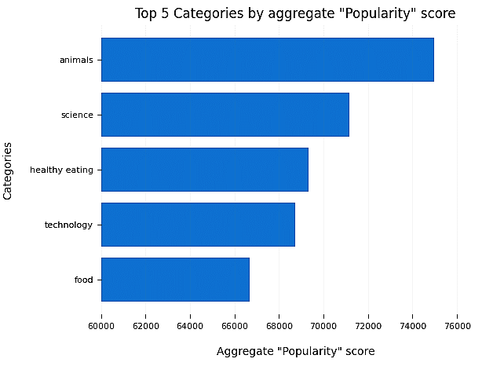
c
Notes:
Based on our analysis, it is evident that the top five most popular post categories, in descending order, were: animals, science, healthy eating, technology, and food.
The category 'Animals' accumulated an aggregate popularity score of approximately 74,965. It is noteworthy to observe both 'Food' and 'Healthy Eating' prominently featured within the top five. This highlights the substantial engagement associated with content pertaining to food. Moreover, the slightly higher ranking of 'Healthy Eating' suggests a potential inclination of your user base towards health-conscious individuals and those with a keen interest in nutrition.
Lastly, it is intriguing to note the inclusion of 'Science' and 'Technology' in the top categories. This may indicate an appetite among users for informative content and morsels of knowledge that offer a learning experience.

Slide 9
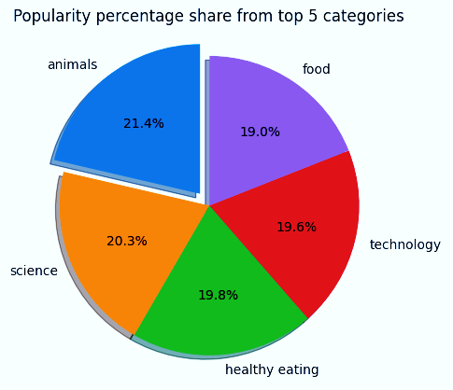
Notes:
Moreover, this chart provides a breakdown of the percentage distribution of popularity among the top five categories. While the variations in share for each category are relatively minor, it is noteworthy that the most substantial gap exists between the first-ranking category, 'Animals', and the second-ranking category, 'Science', amounting to a difference of 1.1%.
From a business perspective, the data indicates a notable divergence in popularity, with the 'Animals' category taking a prominent lead and potentially furthering its popularity. To circumvent a scenario where one content category dominates the platform, it is imperative to implement algorithms that maintain equitable representation across all content categories. This will promote a balanced and diverse content ecosystem.

Slide 10

Summary
ANALYSIS
The data indicates that the categories of animals and science are the most widely favored, suggesting a preference for content grounded in real-life experiences and factual accuracy.
INSIGHT
The prevalent theme within the top five categories revolves around food, with "Healthy Eating" holding the highest rank. This insight potentially offers valuable information about your user base. Consider leveraging this knowledge to formulate a campaign and collaborate with reputable healthy eating brands, thereby enhancing user engagement.
NEXT STEPS
The ad-hoc analysis has yielded valuable insights. It is now opportune to transition towards large-scale production, enabling real-time comprehension of your business dynamics. We are well-equipped to guide you through this process.
Notes:
In summary:
- We successfully addressed this task by identifying the top five most popular categories as requested. Additionally, we took an extra step forward in our analysis.
- Our analysis reveals that the categories of animals and science have emerged as the most favored. This implies a predilection among users for content characterized by real-world experiences and factual accuracy.
- Additionally, our analysis highlighted a prevalent theme in popular content, with 'Healthy Eating' emerging as the most favored subcategory within the food genre. This observation serves as an indication of the platform's user demographic. This valuable insight provides an opportunity to elevate engagement levels even further. For instance, implementing targeted campaigns with a focus on this category or collaborating with reputable healthy eating brands to promote related content can be highly effective strategies.
- While this analysis has provided valuable insights, we are poised to advance to the next phase. Within Accenture, we possess the requisite expertise to assist you in implementing these insights into your organization's operations, in real-time and at scale. We are enthusiastic about the opportunity to support you in this endeavor.

Slide 11
Thank you!
Thank you!!
ANY QUESTIONS?
ANY QUESTIONS?
Notes:
Thank you for your attentive participation. If you have any questions, please don't hesitate to ask.

